Slide 1

CyberPatriot: 2025-26

Slide 2
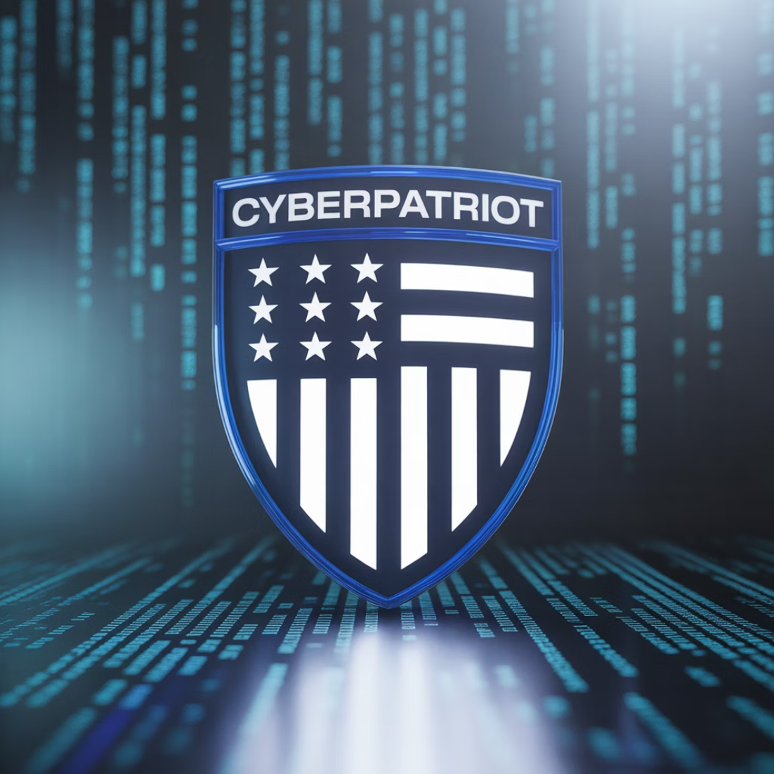
What is Cyberpatriot?
CyberPatriot is the National Youth Cyber Education Program created by the Air Force Association (AFA) to inspire K-12 students toward careers in cybersecurity or STEM fields.
attempts to simulate team environment
finding vulnerabilities
defensive competition
(securing machines)
Established in 2009, CyberPatriot has grown to include thousands of teams nationwide, providing hands-on experience with practical cybersecurity skills in a competitive environment.
Last year # of teams: 3085

Slide 3
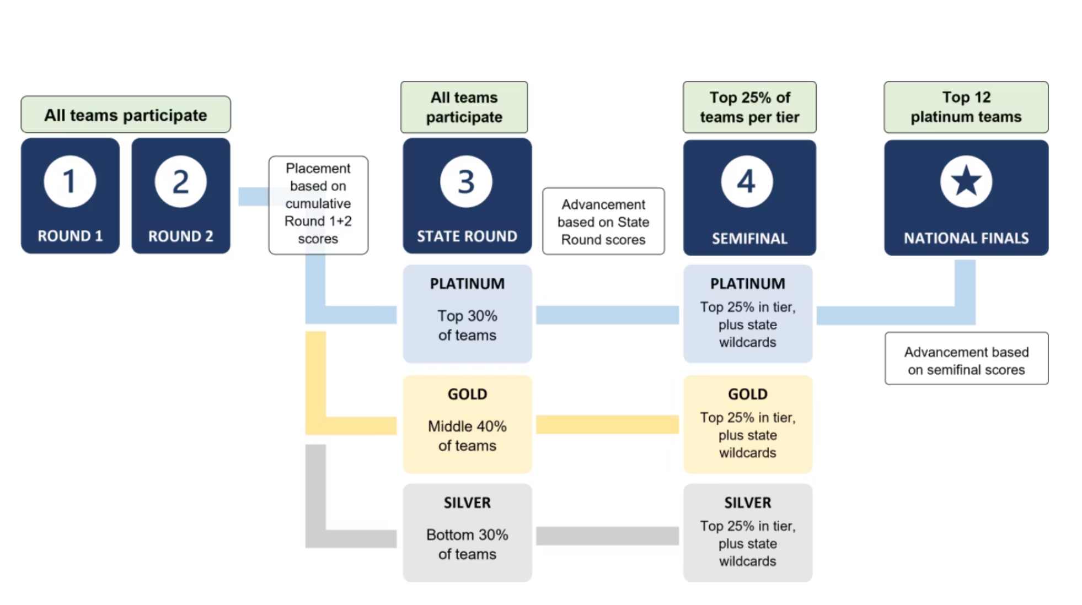
Competition Tiers
rounds progressively get more difficult
gold/silver tiers still look good and reward newer players
we always shoot high for platinum
to be on track for later rounds, place high from start.
2025:
1x Plat state, 1x Plat Semis, 1x Gold Semis

Slide 4
Competition Structure
Image Types
Points
Round
Windows 10
100
1
Ubuntu 22
100
Windows 11
100
2
Windows Server 2022
100
Mint 21
100
Cisco Quiz+Packet Tracer
10+20
Server 2019
100
State
Windows 10
100
Ubuntu 22
100
Cisco Quiz+Packet Tracer
30+70
Windows 11
100
Semifinals
Mint 21
100
Server 2022
100
Cisco Quiz + Packet Tracer
72+168
Web-Based Challenge
80
Boeing Physical System Challenge
80

Slide 5
Cyberpatriot Teams:
We will have 3-4 total teams, depending on signups
The teams will be structured (typically) in the following way
Team 2/3/4
Team 1
1 Linux
1 Linux
2 Windows
2 Windows
1 Cisco
1-2 Cisco
1 Omni, may do whatever requires work
1-2 Omni
1-2 Team captain(s) will be assigned.
1 Team Captain will be assigned.
How will teams be decided?
we already started
Team 1: 2/6 spots up for grabs
Team 2/3/4: All spots up for grabs

Slide 6
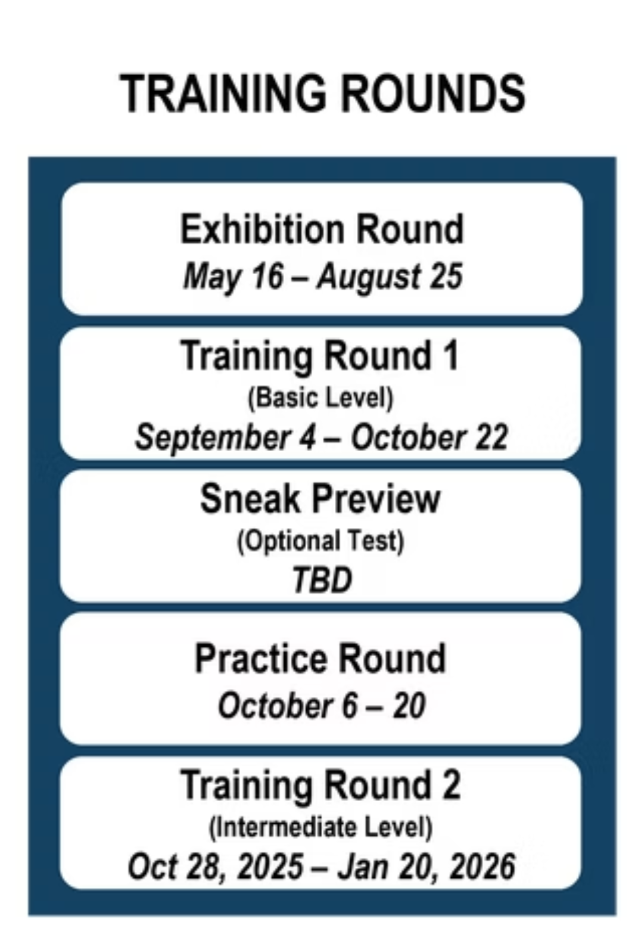
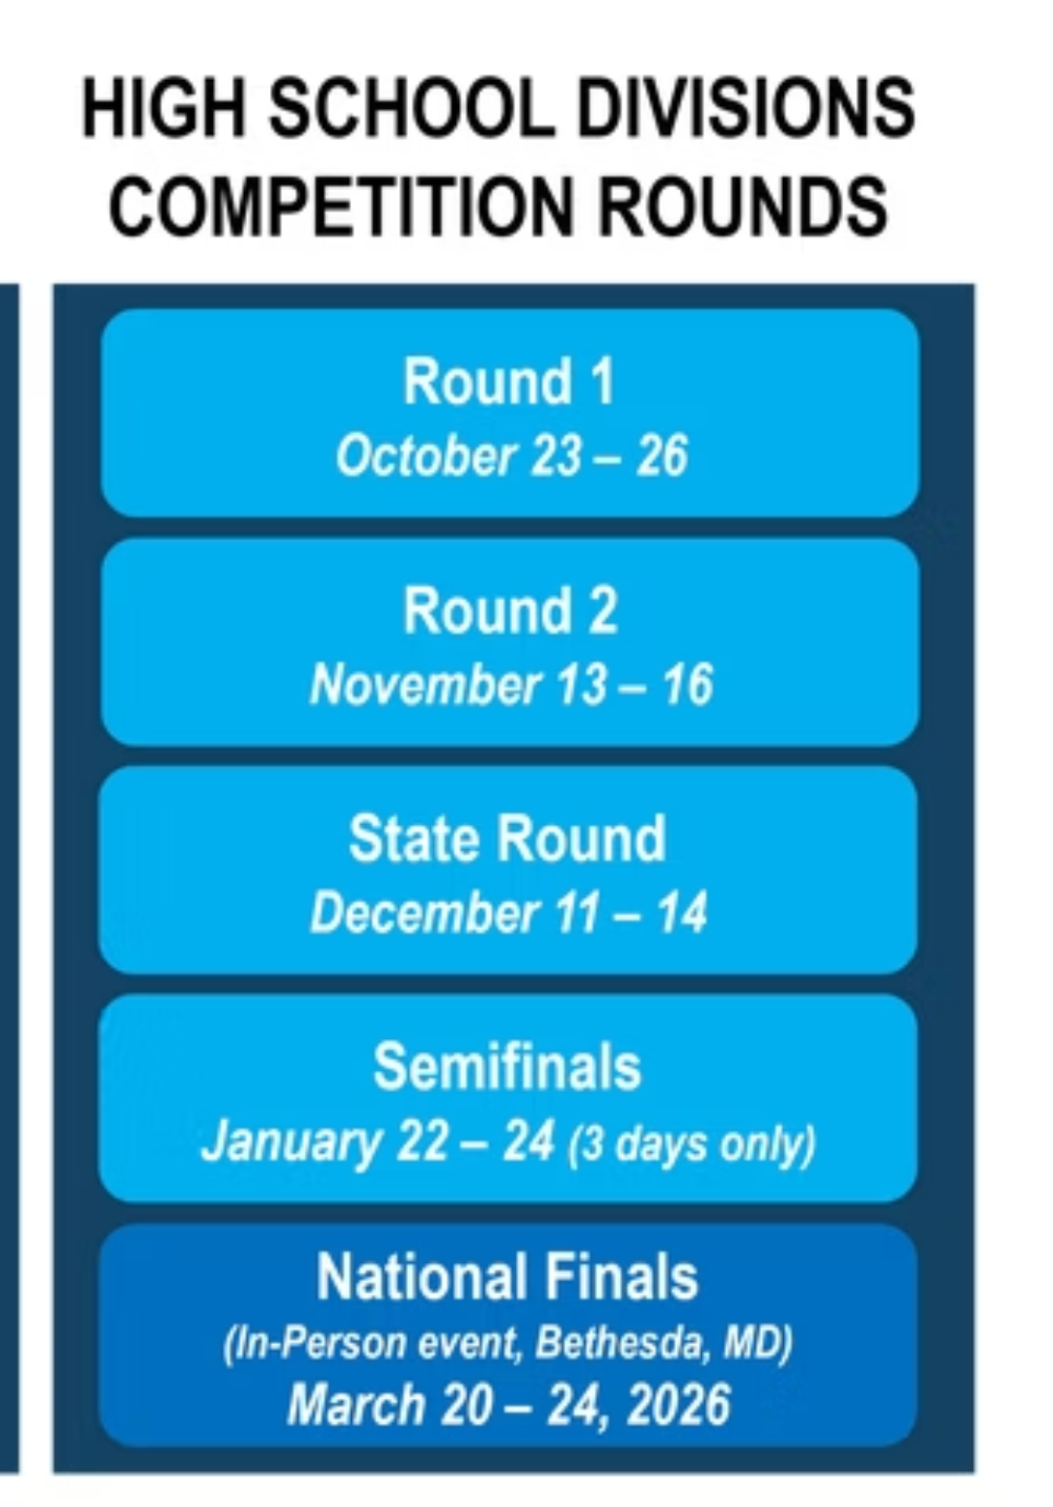
Competition Schedule

Slide 7
Format And Penalties And Restrictions:
Each round is 4 hours, and all images AND cisco must be complete within the 4 hour time frame
the following penalties may be assigned live
the following penalties may be assigned after the competition
The following are considered "deductions" and will be assigned live to images, not teams
Instances of Different Images
Hacking
Shadowing
Reverse Engineering
Time limit exceeded
Image Snapshots
Team interference
key services removed
Copying image information
created new vulnerability
Image Tampering
Social Engineering
DDoS
Penalties may include bans, suspensions, interviews, etc
-
you lose like 10 points

Slide 8
After School meeting schedule
undecided, will be put out asap

Slide 9
FINAL decision deadline to fill out the form:
September 20th

Slide 10
